Slide 1
Week 1
Class Overview and Basic Concepts

Slide 2
Class Overview
At the end of this class, you will have the skills and experience necessary to create WP Apps that:
Use available sensing hardware to sense data needed by your project
Use native (C/C++) code to efficiently process sensed data
Communicate with external hardware, sensing/controlling in real time
You’ll also pick up some useful skills on the side:
An understanding of version control (specifically git and github.com)
Experience with this list of buzzwords: C#, C++, XAML, Visual Studio

Slide 3
Class Overview
Weekly homeworks (50% total grade)
Final group project (50% total grade)
Small groups collaboratively design and implement a sensing/control App
Live demos performed over last two weeks of class
Final project report due during finals week

Slide 4
Class Overview
Homeworks due at the beginning of class
E.g. HW #1 will be due at 6pm on the 7th
Instructor: Elliot Saba
Office (lab, really): CSE 507
TA: Sang Sagong
Office Hours to be decided this class
Notes:
Bear wants Monday or Tuesday

Slide 5
WP8(.1) Basics
Overview of Tools
Application building blocks
Basic User Interface Design
Running apps on an Emulator and the Device

Slide 6
A brief overview of VS
We’ll be using Visual Studio 2013 to construct Apps
VS 2013 includes many powerful tools
First-class support for both C# and C++ (We’ll be using both)
Windows Phone 8 Emulator
Graphical XAML editor
Last but not least, a debugger for Managed (C#) and Native (C++) code

Slide 7
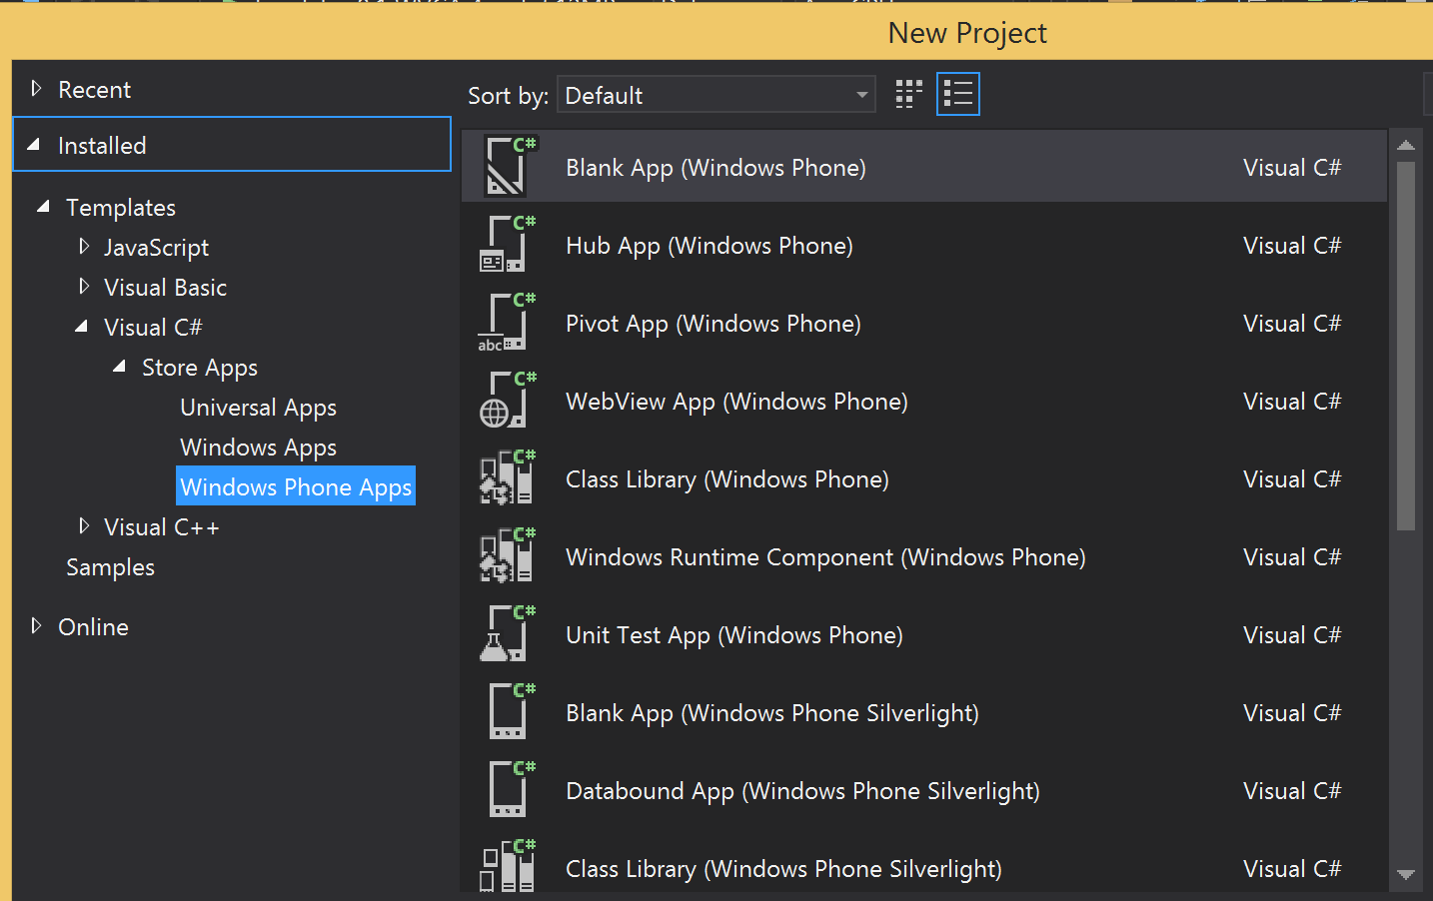
Creating a new project
Creating a new project
We will typically always use the Blank App (Windows Phone) template
We will also use Windows Runtime Components quite a bit, both under the “Visual C#” section, and the “Visual C++” section

Slide 8
Building Blocks
Windows Phone 8 apps are constructed out of at least two components, possibly more:
XAML
GUI
C#
Code
C++/CX
Component
Pure C++ Component
C# Component
Necessary
Additional components
used as needed

Slide 9
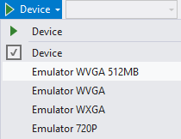
WP8 Emulator
To use, simply change the run target
from “Device” to “Emulator”
Automatically launches on next run/debug
Requires hardware virtualization features
The Emulator is very capable, but also imperfect
Many of the sensing projects we will be exploring will work differently or not at all
Best used as a rapid testing/iteration tool, not your sole development tool!

Slide 10
XAML
eXtensible Application Markup Language
Defines the GUI of the application through a static markup language
Declarative, not Imperative
Based on XML, luckily we have a graphical editor to take the pain out of editing it!

Slide 11
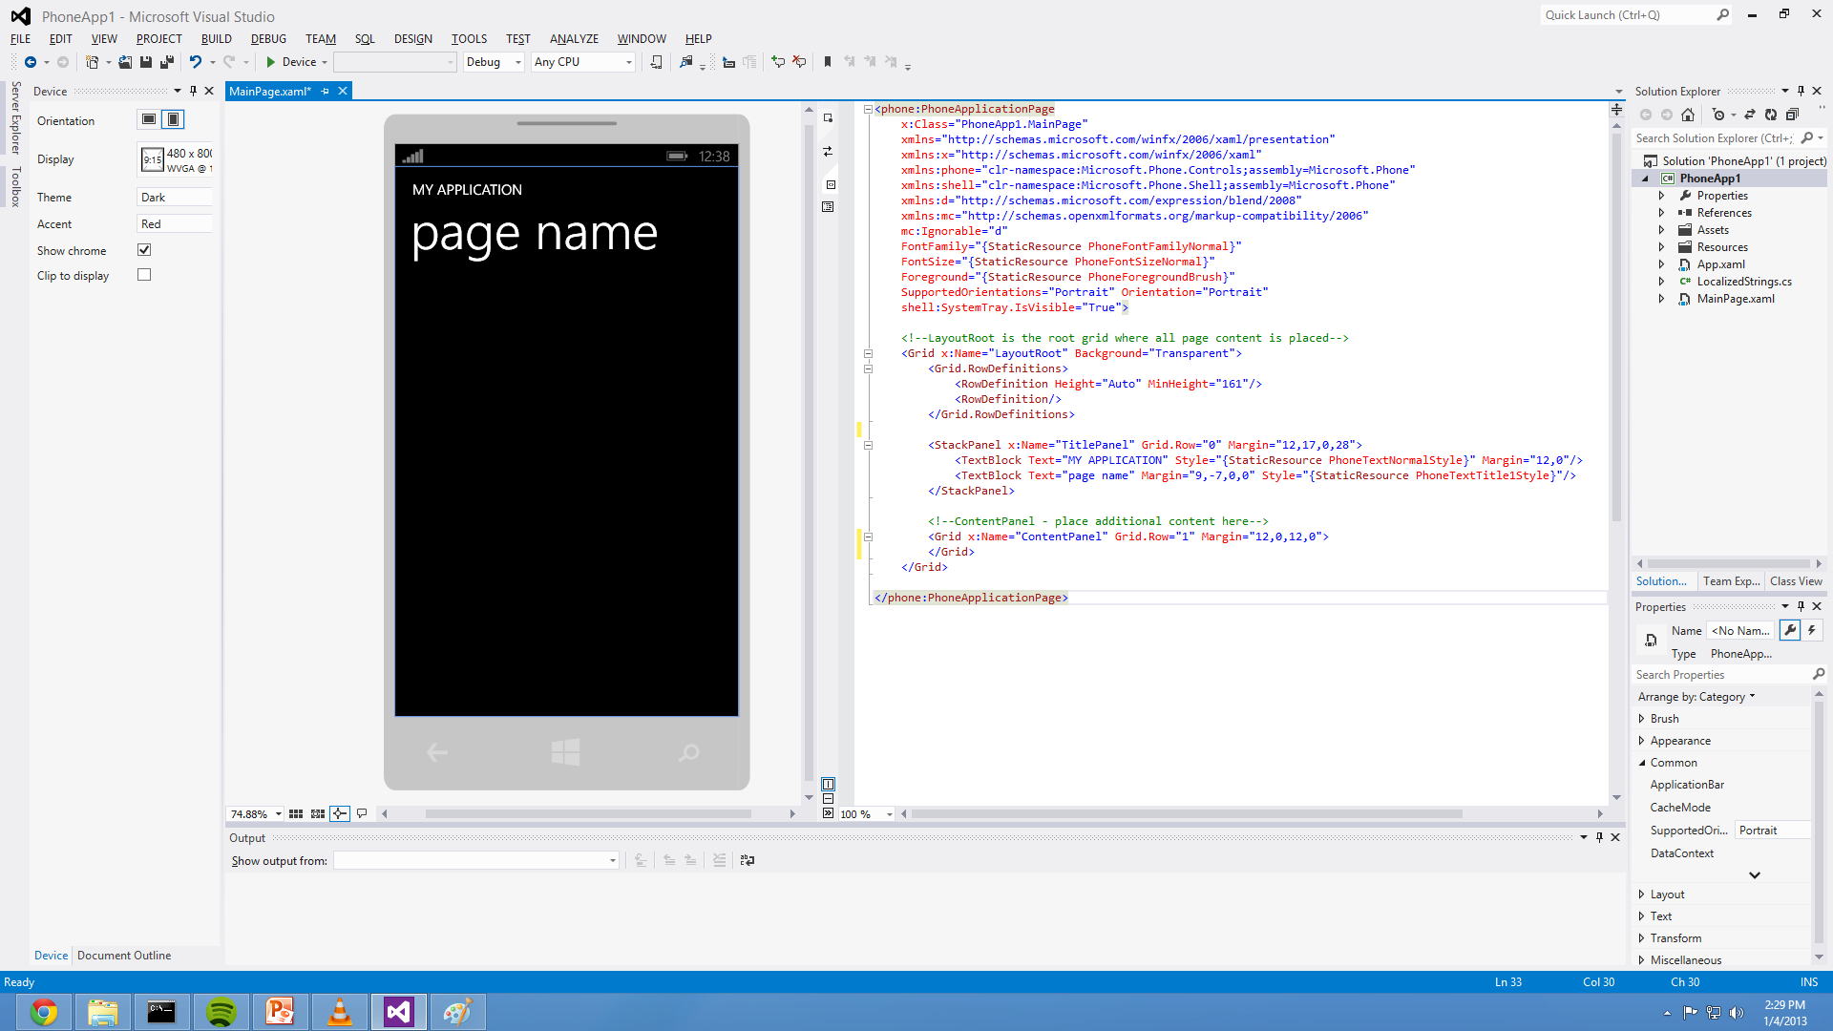
XAML

Slide 12
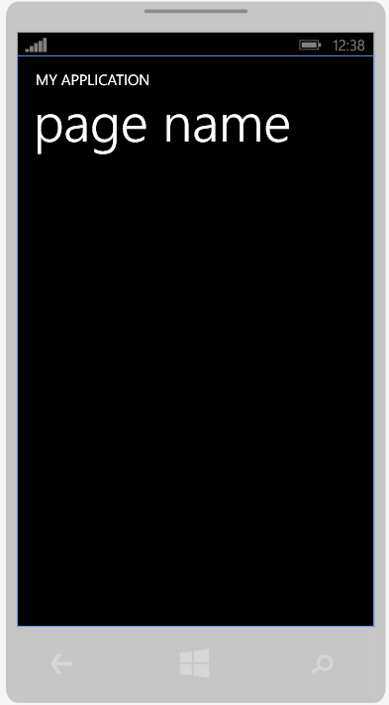
XAML
<phone:PhoneApplicationPage
x:Class="PhoneApp1.MainPage"
xmlns="http://schemas.microsoft.com/winfx/2006/xaml/presentation"
xmlns:x="http://schemas.microsoft.com/winfx/2006/xaml"
xmlns:phone="clr-namespace:Microsoft.Phone.Controls;assembly=Microsoft.Phone"
xmlns:shell="clr-namespace:Microsoft.Phone.Shell;assembly=Microsoft.Phone"
xmlns:d="http://schemas.microsoft.com/expression/blend/2008"
xmlns:mc="http://schemas.openxmlformats.org/markup-compatibility/2006"
mc:Ignorable="d"
FontFamily="{StaticResource PhoneFontFamilyNormal}"
FontSize="{StaticResource PhoneFontSizeNormal}"
Foreground="{StaticResource PhoneForegroundBrush}"
SupportedOrientations="Portrait" Orientation="Portrait"
shell:SystemTray.IsVisible="True">
<!--LayoutRoot is the root grid where all page content is placed-->
<Grid x:Name="LayoutRoot" Background="Transparent">
<Grid.RowDefinitions>
<RowDefinition Height="Auto" MinHeight="161"/>
<RowDefinition/>
</Grid.RowDefinitions>
<StackPanel x:Name="TitlePanel" Grid.Row="0" Margin="12,17,0,28">
<TextBlock Text="MY APPLICATION" Style="{StaticResource PhoneTextNormalStyle}" Margin="12,0"/>
<TextBlock Text="page name" Margin="9,-7,0,0" Style="{StaticResource PhoneTextTitle1Style}"/>
</StackPanel>
<!--ContentPanel - place additional content here-->
<Grid x:Name="ContentPanel" Grid.Row="1" Margin="12,0,12,0">
</Grid>
</Grid>
</phone:PhoneApplicationPage>

Slide 13
XAML
<!--LayoutRoot is the root grid where all page content is placed-->
<Grid x:Name="LayoutRoot" Background="Transparent">
<Grid.RowDefinitions>
<RowDefinition Height="Auto" MinHeight="161"/>
<RowDefinition/>
</Grid.RowDefinitions>
<StackPanel x:Name="TitlePanel" Grid.Row="0" Margin="12,17,0,28">
<TextBlock Text="MY APPLICATION" Margin="12,0"/>
<TextBlock Text="page name" Margin="9,-7,0,0"/>
</StackPanel>
<!--ContentPanel - place additional content here-->
<Grid x:Name="ContentPanel" Grid.Row="1" Margin="12,0,12,0">
</Grid>
</Grid>

Slide 14
XAML
<!--LayoutRoot is the root grid where all page content is placed-->
<Grid x:Name="LayoutRoot" Background="Transparent">
<Grid.RowDefinitions>
<RowDefinition Height="Auto" MinHeight="161"/>
<RowDefinition/>
</Grid.RowDefinitions>
<StackPanel x:Name="TitlePanel" Grid.Row="0" Margin="12,17,0,28">
<TextBlock Text="MY APPLICATION" Margin="12,0"/>
<TextBlock Text="page name" Margin="9,-7,0,0"/>
</StackPanel>
<!--ContentPanel - place additional content here-->
<Grid x:Name="ContentPanel" Grid.Row="1" Margin="12,0,12,0">
</Grid>
</Grid>

Slide 15
XAML
<!--LayoutRoot is the root grid where all page content is placed-->
<Grid x:Name="LayoutRoot" Background="Transparent">
<Grid.RowDefinitions>
<RowDefinition Height="Auto" MinHeight="161"/>
<RowDefinition/>
</Grid.RowDefinitions>
<StackPanel x:Name="TitlePanel" Grid.Row="0" Margin="12,17,0,28">
<TextBlock Text="MY APPLICATION" Margin="12,0"/>
<TextBlock Text="page name" Margin="9,-7,0,0"/>
</StackPanel>
<!--ContentPanel - place additional content here-->
<Grid x:Name="ContentPanel" Grid.Row="1" Margin="12,0,12,0">
</Grid>
</Grid>

Slide 16
XAML
Defines elements (TextBlock, etc…) hierarchically
Can manipulate attributes attached to these elements: Text, Font, Position, Color, Name, etc…
This idea extends to events, such as clicking etc.
All of this can be setup programmatically, but it’s much easier to do graphically with an editor

Slide 17
XAML Live Demo

Slide 18
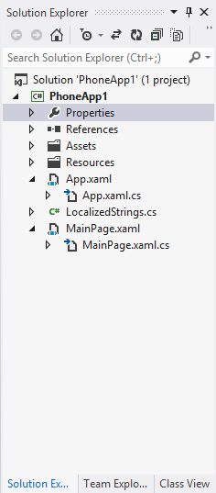
XAML/C# Interaction
Every XAML file has a C# source file paired with it
These .xaml.cs files define UI behavior,
and provide access to the UI elements
within the XAML hierarchy
This provides the foundation for XAML-
C# interaction

Slide 19
C#
C# is an object-oriented, general-purpose programming language, developed by Microsoft
C# has many pros:
Easy to use
Lots of libraries and integration with the platform for almost any task
Interfaces with XAML to provide interactive User Interfaces extremely quickly and flexibly
C# has a few cons (for our purposes):
Relatively slow (A direct consequence of its ease of use)
Not particularly well suited for data processing/analysis

Slide 20
C# example.cs
// MainPage.xaml.cs
using System.Windows.Navigation;
using Microsoft.Phone.Controls;
using Microsoft.Phone.Shell;
using PhoneApp1.Resources;
namespace PhoneApp1
{
public partial class MainPage : PhoneApplicationPage
{
// Constructor
public MainPage()
{
InitializeComponent();
}
}
}

Slide 21
C# breakdown
using System.Windows.Navigation;
Enables our code to use objects defined in the System.Windows.Navigation namespace
Similar constructs exist in C, C++, Java, Objective-C, etc. in the form of keywords such as using, import, #include, etc …
All this does is allows us to type Foo instead of System.Windows.Navigation.Foo
This is a convenience, the way to link in external code is through “References”, more on that later

Slide 22
C# breakdown
namespace PhoneApp1
{
...
}
Defines a new “namespace”
Separates the names of classes, functions, variables, etc… to avoid conflicts

Slide 23
C# breakdown
public partial class MainPage : PhoneApplicationPage
{
...
}
Defines a new “class”
public allows any other class to create a MainPage
partial tells the compiler that the class can be spread over many files
: PhoneApplicationPage causes MainPage to inherit from the super class PhoneApplicationPage, thereby gaining functionality and state from it

Slide 24
C# breakdown
// Constructor
public MainPage()
{
InitializeComponent();
}
Defines a new “method”
Finally, a line that actually that DOES something
Again, public denotes a method that can be called from any class

Slide 25
XAML/C# Live Demo

Slide 26
XAML/C# Live Demo
What we just did:
Added a button
Generated C# code to change the XAML, live
Hooked up the C# code to a XAML event
Things to remember:
How to add events to XAML objects
XAML objects that are named have C# objects with the same name

Slide 27
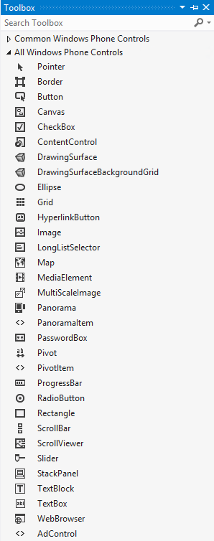
Basic UI Elements
Available in VS “Toolbox”
Drag-n-Drop
Things we’ll be using today:
Pivot
Grid
Button
TextBlock (Output)
TextBox (Input)

Slide 28
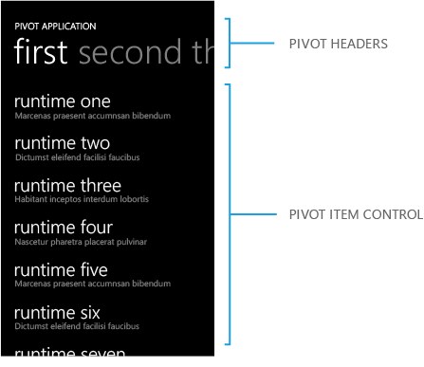
Pivot Control

Slide 29
Pivot Control
Gives a very “Windows Phone” look
Swipe left/right to change pages
Fairly simple representation in XAML
Overall Pivot Object
Nested PivotItem Objects
Nested Transform and Grid Objects

Slide 30
Live Pivot Demo

Slide 31
C++
C++ (Native) code runs fast
Pros:
Speed, speed, and more speed
Large opensource libraries available to us (FFTW, Open CV, etc…)
Cons:
Slight overhead involved when moving between C# and C++
Speedy code typically means more work for the programmer
Pure C++ can’t interface directly with C#, you must use C++/CX

Slide 32
C++/CX
A Microsoft extension to C++
Adds Memory Management and libraries to interface with C#, Javascript
Must be used when interfacing with C#
We won’t go indepth with C++, will cover the basics
If you want to deal with C++ regularly, the more experience you have the happier you will be!
C++/CX has a lot of “boilerplate code”, it’s not as scary as it looks!

Slide 33
C++/CX Concepts
We will create a “C++ component” and link it into our C# project via a “Reference”
This component will define classes that will be instantiated into objects in C#
C# directly calls methods defined in those objects
There are data types for passing data structures (e.g. arrays) between C# and C++ code

Slide 34
C++/CX breakdown
// CppCounter.h
#pragma once
namespace CppCounter
{
public ref class FirstCppCounter sealed
{
public:
FirstCppCounter();
};
}

Slide 35
C++/CX breakdown
// CppComponent.cpp
#include "pch.h"
#include “CppCounter.h"
using namespace CppCouner;
using namespace Platform;
FirstCppCounter::FirstCppCounter()
{
}

Slide 36
C++/CX: Method Calls
Let’s actually do something
C# will instantiate C++ class CppCounter
The C++ class will define a method, incrementBy()
Accepts an integer, increments its internal counter, returns the counter
The C# code will call this method when a button is pushed, and display the output to the XAML

Slide 37
C++/CX: Method Calls
// CppCounter.h
#pragma once
namespace CppCounter
{
public ref class FirstCppCounter sealed
{
private:
int counter;
public:
FirstCppCounter();
int incrementBy( int delta );
};
}

Slide 38
C++/CX: Method Calls
// CppCounter.cpp
#include "pch.h"
#include "CppCounter.h"
using namespace CppCounter;
FirstCppCounter::FirstCppCounter()
{
this->counter = 0;
}
int FirstCppCounter::incrementBy( int delta )
{
this->counter += delta;
return this->counter;
}

Slide 39
C++/CX: Method Calls
// MainPage.xaml.cs
using CppCounter;
namespace CppTest
{
public partial class MainPage : PhoneApplicationPage
{
private FirstCppCounter cppCounter = new FirstCppCounter();
// Constructor
public MainPage()
{
InitializeComponent();
}
private void incButton_Click(object sender, RoutedEventArgs e)
{
int result = cppCounter.incrementBy(2);
this.TextOutput.Text = "Counter: " + result;
}
}
}

Slide 40
Live C++/CX Demo

Slide 41
Debugging
Very familiar for anyone who has used VS before
Breakpoints, watch variables, etc. are all available
Both emulator-targeted and device-targeted
Due to a technical limitation, native (C++) debugging and managed (C#) debugging are mutually exclusive

Slide 42
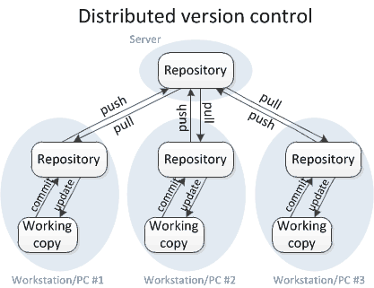
Github
We’re going to use Github in this class
Distributed version control at its simplest

Slide 43
Github
Quick git vernacular:
commit: An atomic set of changes to the repository
branch: A series of commits, ending in the current HEAD commit
Default branch name: master
fork: A complete copy of another repository
merge: Merging commits from one branch into another
push/pull: Copying commits from one fork to another

Slide 44
Github
Version control allows us to:
Share code efficiently, with no fear of overwriting things forever
Rollback to previous states easily
View changes from one commit to another
See who changed what
Much, much more

Slide 45
Github live demo

Slide 46
Homework #1
Three phases
First phase: Setup and text input
Add a TextBox, TextBlock, and a Button
Use the button to convert the Textbox to an integer, add it to a counter, and display it in the TextBlock
Second phase: Add a panorama control
Use the panorama control to have two pages
Have two buttons with separate counters and text controls
Third phase: Link in a C++ component
Final app should have two pages
One with a C# counter
One with a C++ counter
Yes, you will wrap the C++ code in C# calls, as XAML only calls C#

Slide 47
Homework #1
Due at the beginning of class next week
6pm April 7th
Github will serve as the primary materials collection
Slides, Sample code, Homework templates/requirements, etc…
Deliverables must be sent to the class dropbox

Slide 48
Helpful Links for HW #1
Converting a string to a number in C#
MSDN Article
A brief overview of Pivot Controls
MSDN Article
A tutorial on using C++ components in C#
Online tutorial
Git/Github help
Online help center

Slide 49
Useful Software Links
Windows Phone 8.1 SDK
Download, available to anyone
Developer Registration for Windows Phone 8.1
Instructions, necessary for each phone, to allow apps to be side-loaded
Note that to run the emulator, you need a Professional or higher version of Windows!

